Slide 1
The battle of Neighborhoods in North York
Georgios Papanikolaou
Coursera Capstone final project
rECOMMENDATION OF BEST LOCATION FOR ‘MEDITERRANO’ RESTAURANT

Slide 2
Contents
INTRODUCTION
DATA REQUIREMENTS
METHODOLOGY
RESULTS
DISCUSSION
CONCLUSION

Slide 3
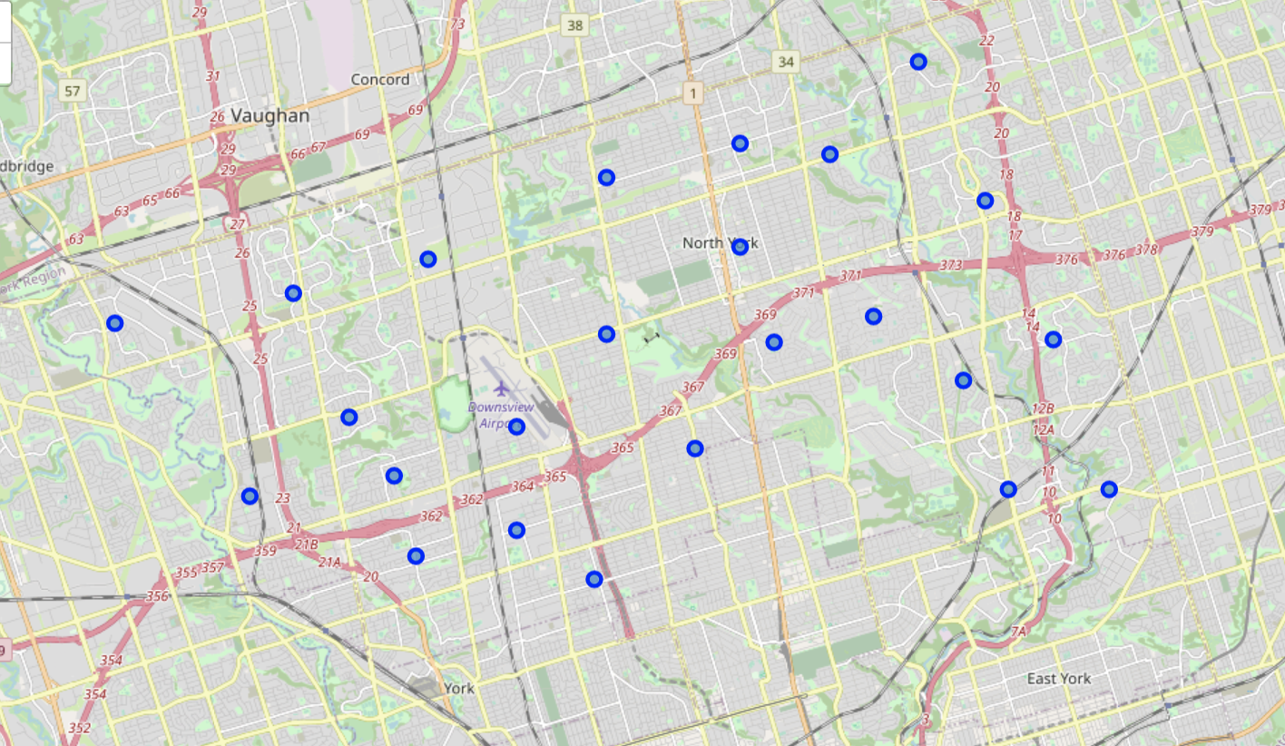
INTRODUCTION
A Mediterranean restaurant named ‘Mediterrano’ is interested to open its new business unit in North York but first they have requested from us an analysis in the different neighborhoods of North York and the most common venues in order to find the optimal location to open their new restaurant.
Overview of neighborhoods of North York in Toronto
Distribution of different venues in each neighborhood
Location of the new business unit should be:
In a district where there is high demand for a Mediterranean restaurant
Low competition from other similar businesses

Slide 4
DATA
Requirements:
Geospatial data for every information
Venues data for each neughborhood
Sources
Foursquare.com
Wikipedia Pages
Csv that was provided in IBM course with the coordinates of every neighborhood in Toronto
Processes
Data cleaning to make the datasets that are used homogeneous in order to have the right format to be used for machine learning algorithms which will help in the analysis
K-Means algorithm for analysis of each neighborhood in North York

Slide 5
METHODOLOGY
The initial step was to scrap the data required for the analysis from Wikipedia. The data processed in order to have a structured format
Api call was made from Foursquare in order to retrieve the data related to different venues in every neughborhood
K-Means machine learning technique was used to segment and cluster the neughborhoods considering their similarity and then grouped together using the most common venues
Comparison between the different neighborhoods and their venues in order to find the best location considering high demand and less compatition

Slide 6
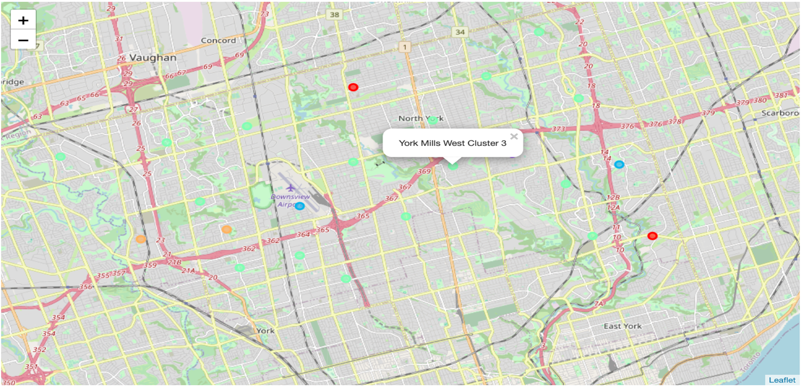
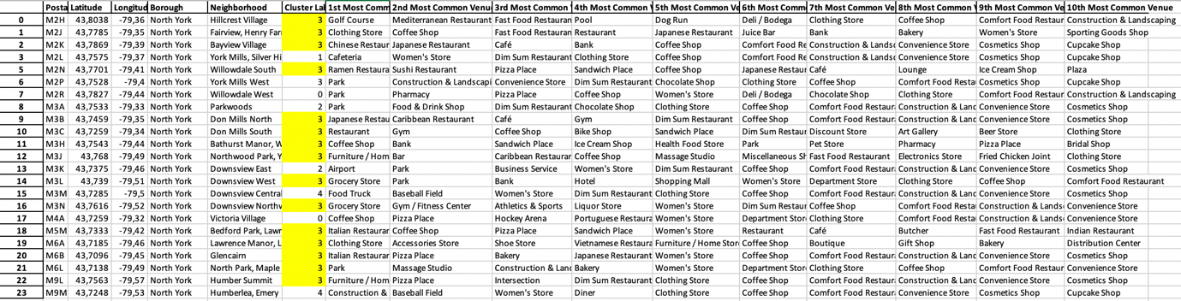
RESULTS
Using the K-Means we managed to group the neighborhoods of North York in 5 different Clusters
Venue’s data was retrieved and analysed in order to find the best location for the new business unit of ‘Mediterrano’
Comparing the results Cluster 3 is the most dominant with many different choices and especially in the Food industry. Therefore, we should find a district in this cluster where the competition is lower, and the new restaurant will have more advantages and a faster growth rate which is important in the very first steps.

Slide 7
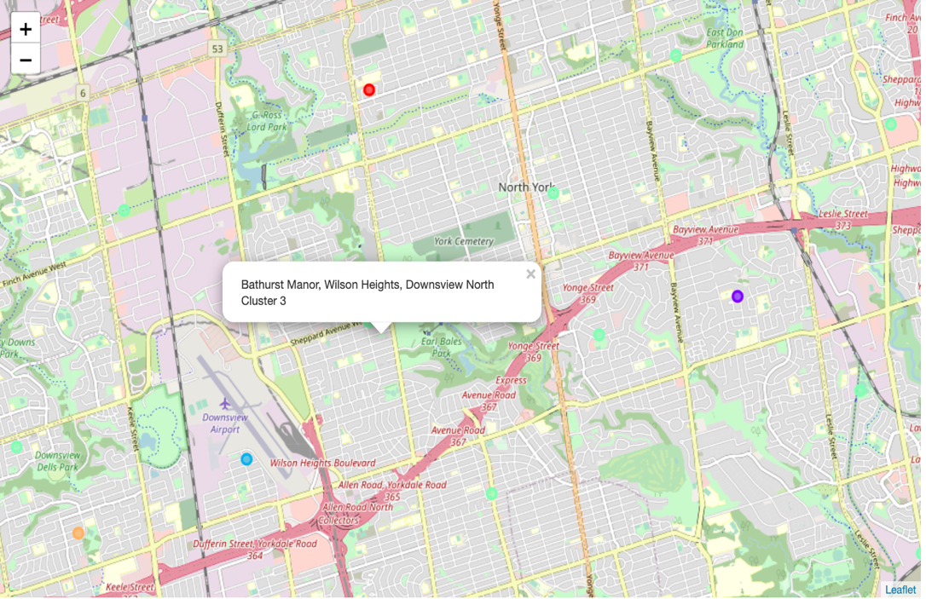
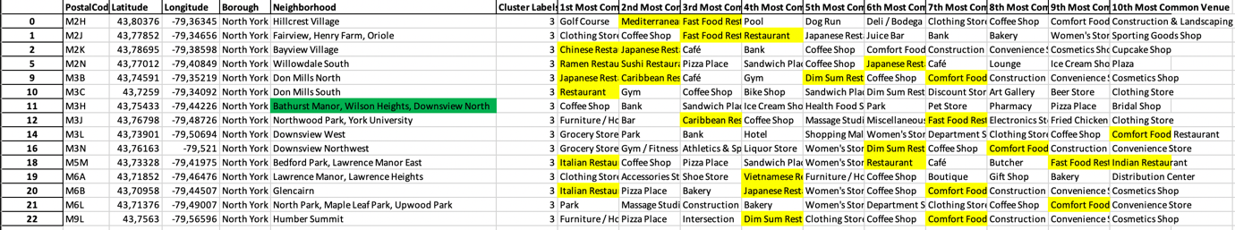
DISCUSSION
Comparing the number and the type of restaurants in each neighborhood of the 3rd cluster we recommend a neighborhood where the supply is lower and ‘Mediterrano’ will be able to succeed even faster. The neighborhood which is selected as the optimal is Bathurst Manor, Wilson Heights, Downsview North.

Slide 8
CONCLUSION
Recommended region:
Region: 3rd Cluster
Neighborhood names: Bathurst Manor, Wilson Heights, Downsview North.
Other offers in the district: Sandwich Place, Ice Cream Shop, Health Food Store, Park, Pet Store, Pharmacy, Pizza Place
Supplier in the same district offer primarily fast food, therefore this specific region is missing of a restaurant especially one that can offer Mediterranean food. It is also important that in the region there is also Earl Bales Park which is a large city Park which we strongly believe that it will help ‘Mediterrano’ to attract new customers.

